Slide 1
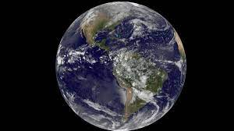
Debunking : Flat Earth Theory
By :
Moiz Ansari (23i-0523)
Muhammad Saad (23i-0667)
Ibrahim-bin-Umair (23i-0520)

Slide 2
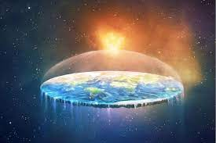
What?
Myth of Flat Earth Theory
Historical context

Slide 3
Why?
Circumnavigation of various explorers
Space exploration in the previous century
Laws of physics

Slide 4
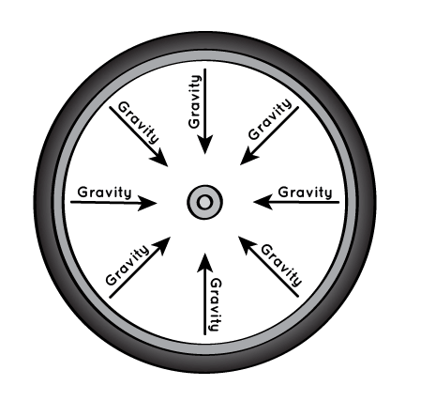
How?
Eratosthenes checked the angle of sunlight
Magellan-Elcano proved that Earth is round through his voyages
Space programs, provided images
Gravity
Lunar Eclipse
Notes:
Eratosthenes: Sunlight in Alexandria fell at an angle of about 7 percent from the vertical at noon on the summer solstice, while 500 miles (800 kilometers) to the southeast.

